Slide 1

EDM 2016
Resources
Workshop Schedule
Mox Slides
Google Notes for this Meeting
Mindomo version of WA
  Coggle
  Google Drawings
Dropbox folder with the full articles

Slide 2

Joseph Moxley: mox@usf.edu
Katie Walkup: kwalkup@mail.usf.edu
Alex Rudniy: arudniy@fdu.edu
Norbert Elliot: elliot@njit.edu
David Kaufer: kaufer@andrew.cmu.edu
Suguru Ishizaki: suguru@cmu.edu
Valerie Ross: vross@writing.upenn.edu
Mark Liberman: myl@cis.upenn.edu
Lan Ngo: lngo@writing.upenn.edu
Rodger LeGrand: legrand@writing.upenn.edu
Chris Holcomb: holcombc@mailbox.sc.edu
Duncan Buell: buell@acm.org
Denise Comer: comerd@duke.edu
Presenter Information

Slide 3
The workshop
aims to generate cross-disciplinary research among writing program directors and faculty, computational linguists, computer scientists, and educational measurement specialists
questions ways writing analytics and data mining can be used to improve on existing methods for responding to and assessing student writing
invites researchers in the domains of data mining, writing analytics, and writing studies to engage in a creative interdisciplinary exploration of how digitally based writing analytics might improve students’ cognitive, intrapersonal and interpersonal competencies as writers, and also provide new analytic tools for assessing this improvement
invites participants to brainstorm about ways analytics can improve document critique, peer review, and writing program assessment.

Slide 4
What are Writing Analytics?
“Broadly defined, writing analytics involves the measurement and analysis of written texts for the purpose of understanding writing processes and products, in their educational contexts. Writing analytics are ultimately aimed at improving the educational contexts in which writing is most prominent. The principal goal of writing analytics is to move beyond assessment of texts divorced from contexts, transitioning instead to a more nuanced investigation of how analytics may be effectively deployed in different writing contexts.”
-- Buckingham Shum et al., 2016

Slide 5
What are Writing Analytics?
Writing Analytics refers to data generated by digital tools for specific stakeholders, including students, instructors, writing program administrators. The data may be formative (such as suggestions for improving drafts) or summative (such as graded papers. The data may be merely descriptive, such as the word count of a student's peer review comments or the correlation between a student’s rubric scores and her peers’ scores or her instructor's scores. Typically WAs are developed by datamining corpuses: intentional measures, volunteered information, surveillance corpora. WAs may be based on complex algorithms--a compilation of diverse datasets and corpuses, such as students’ essays, students’ comments on essays, students’ paper scores by instructors, etc. WAs have the potential to inform the methods of diverse research communities, including the work of scholars, empiricists, and teacher-researchers. Ideally WAs are actionable: they are context specific, personalized, and designed to structure students’ opportunities to learn. While our focus is primarily educational, WAs can be used in academic, business, and cultural domains.

Slide 6
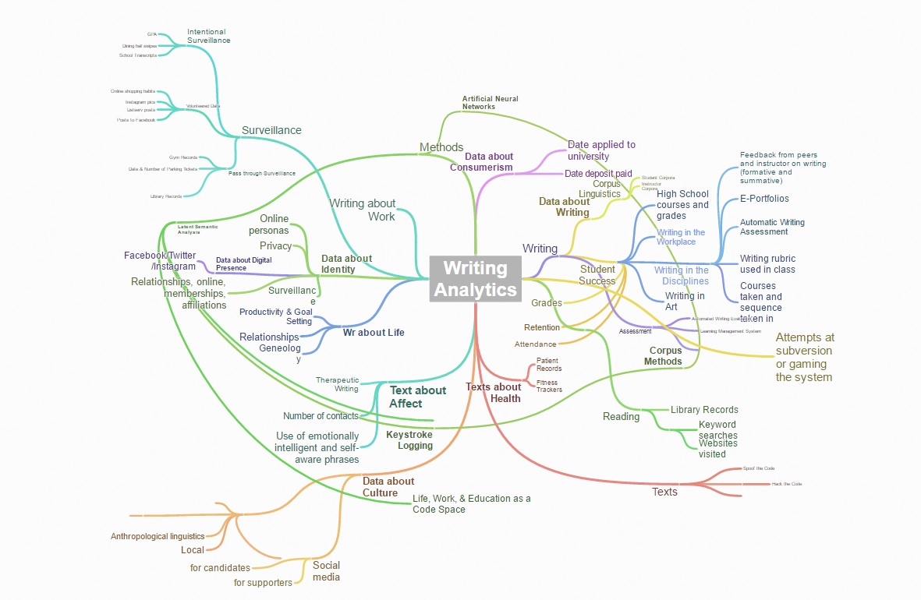
First attempt at mapping WA

Slide 7
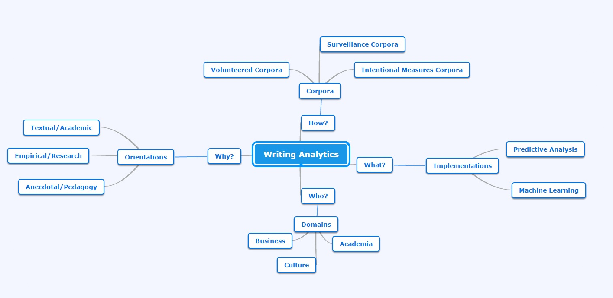
Second attempt at mapping WA

Slide 8


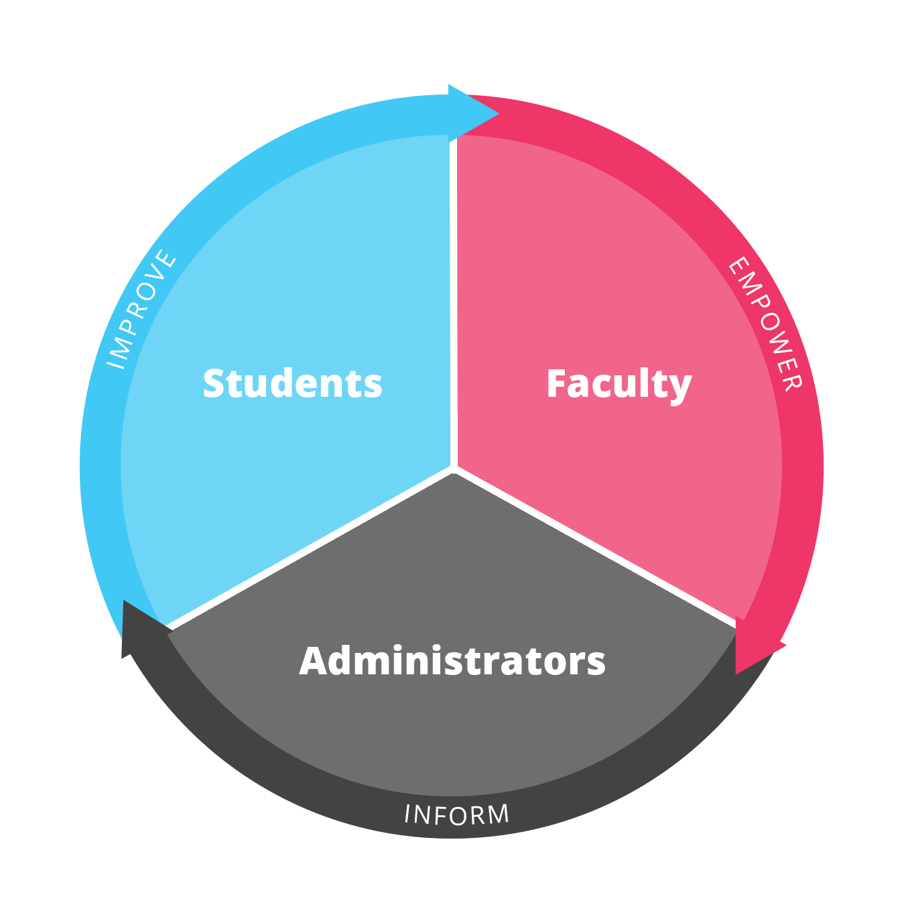

My Reviewers (as a case study)
Joe Moxley and Katie Walkup, University of South Florida
*This research is supported by the National Science Foundation under Award #154423

Slide 9

My Reviewers: What Is It?
A comprehensive suite of tools, My Reviewers is:
an e-learning environment
a document markup tool that facilitates peer review and team projects
an e-portfolio tool
an assessment tool
a publication platform for e-texts
a research project for universities to examine student success, pedagogy, the development of writing competencies, and more

Slide 10
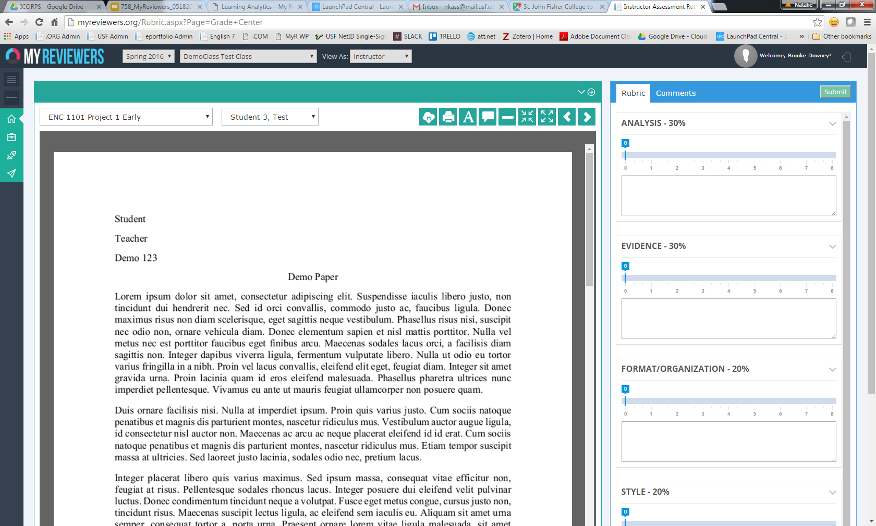
Grading Tools

Slide 11
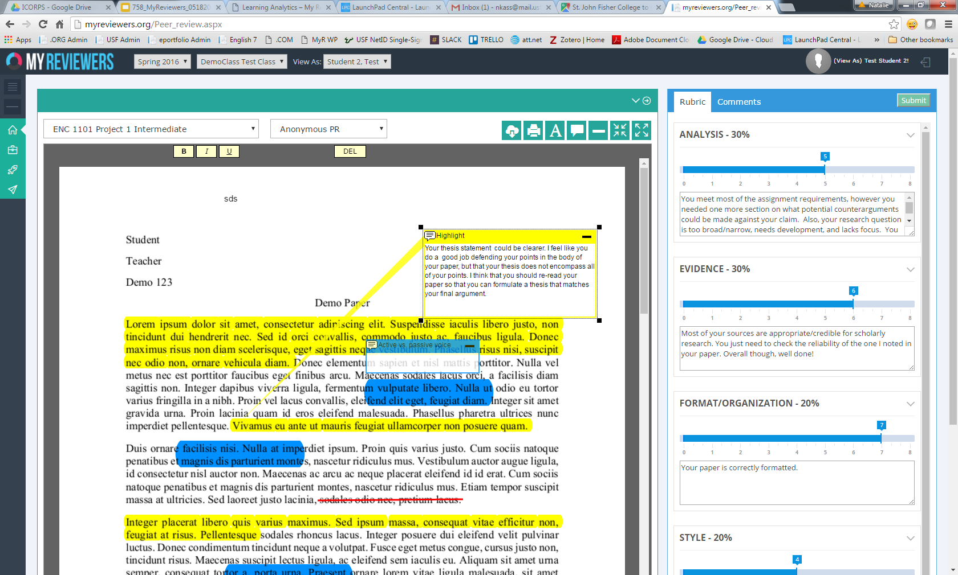
Peer Review

Slide 12
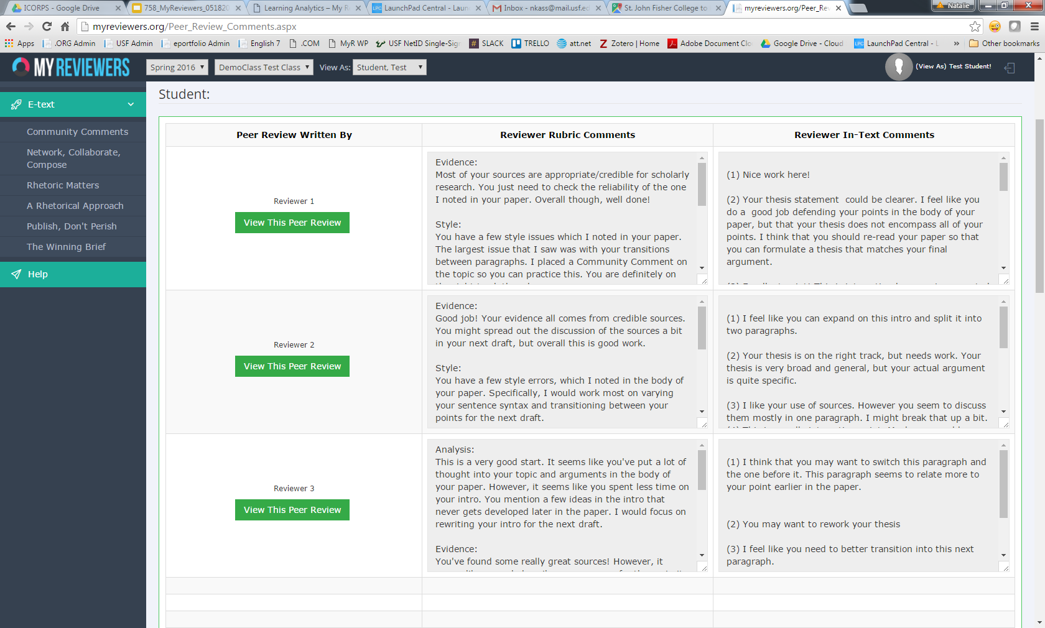
Revision Plan

Slide 13
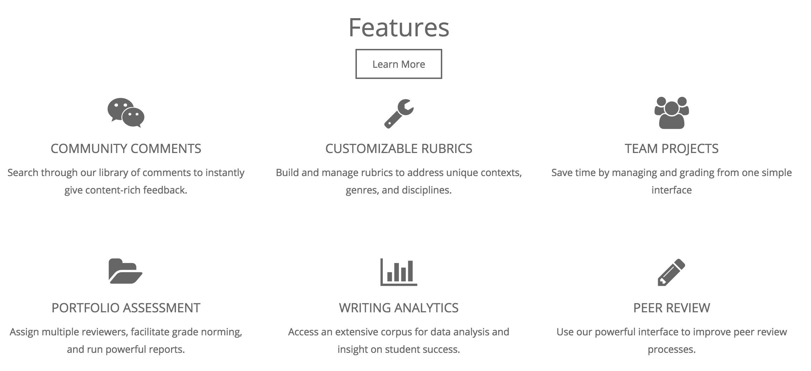
http://myreviewers.com

Slide 14

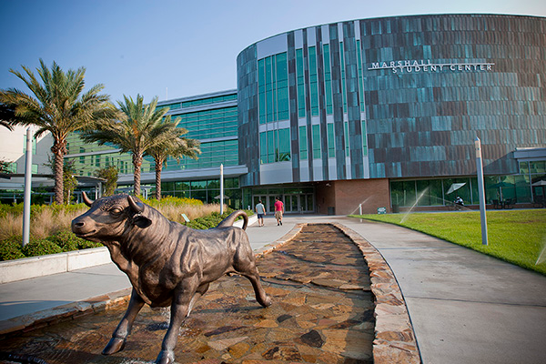
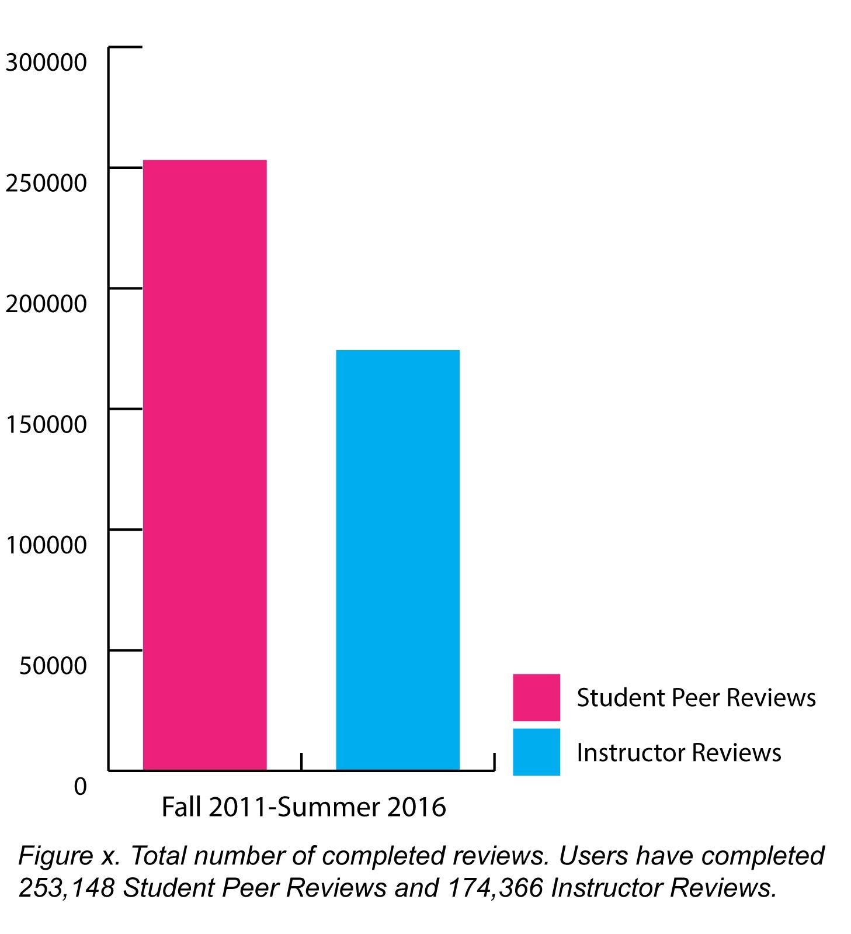
My Reviewers @ USF
From the Fall 2009 to the Spring of 2016, students have completed 253,148 peer reviews and instructors have completed 174,366 reviews

Slide 15

Chemistry Courses @ USF
We began our partnership with the USF Chemistry department in the Spring 2016 term. The courses that use My Reviewers include:
    CHM 3941 (Peer Leading)
    CHM 4411 (Physical Chem)
    CHM 2045 (Gen Chem 1)
    CHM 2046 (Gen Chem 2).
Courses use My Reviewers for peer reviews and final grading of lab and research reports
N = 2,027 students and 6,517 reviews
Notes:
Spring 2016 STEM Corpus
MIT 0 drafts
NCSU: 84 drafts
Dartmouth: 118 drafts
UPenn: 9,190 drafts
USF Chemistry: 6,517 drafts

Slide 16
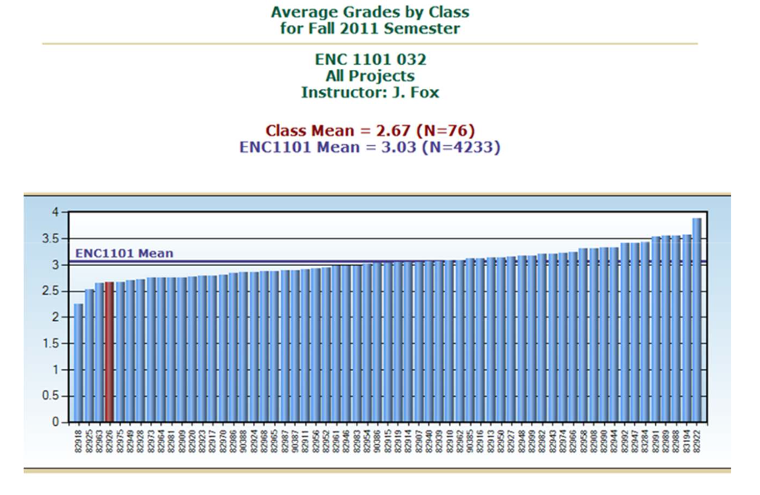
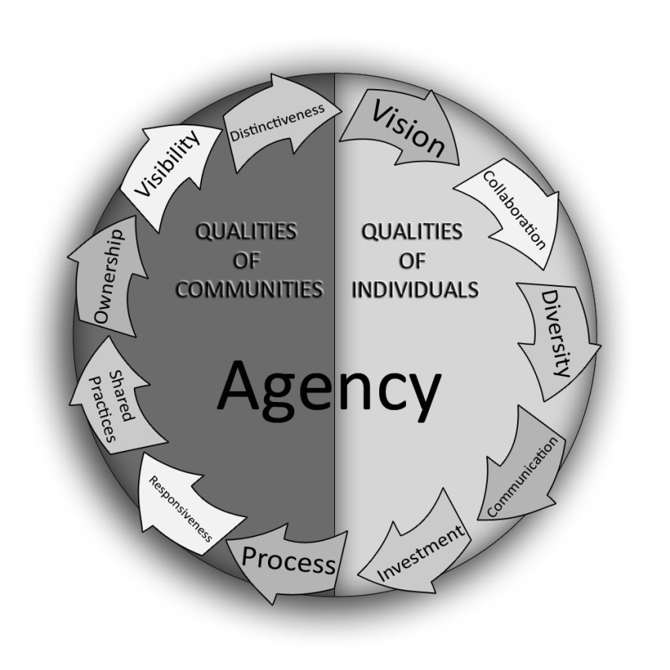
Grading (and commenting) habits by instructors are measurably consistent from one semester to another for individual raters, but some rate higher than others.
Source: Vieregge 2011
Improve mentoring
Notes:
Source: Moxley, J. M. (2012). Aggregated assessment and objectivity 2.0. Proceedings of the Second Workshop on Computational Linguistics and Writing (CLW 2012): Linguistic and Cognitive Aspects of Document Creation and Document Engineering. Avignon, France.

Slide 17
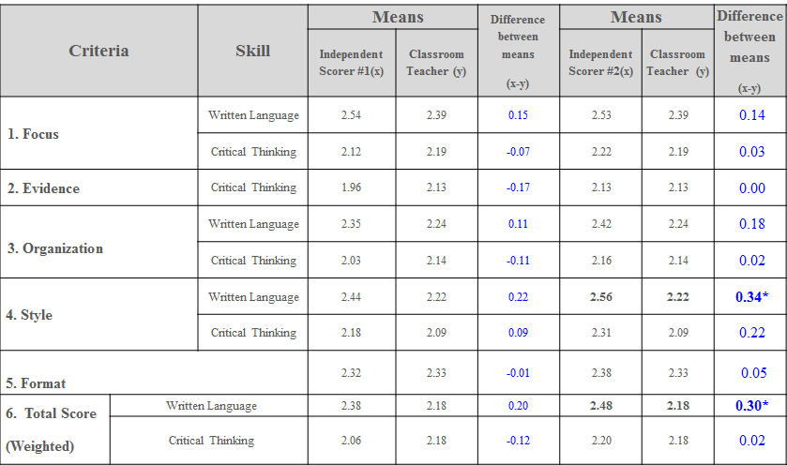
N = 249 essays from Project 2 in ENC 1101 and 249 essays by same students for Project 2 in ENC 1102. T test comparison between independent scorers and classroom instructors. Source: Moxley 2012
Provide shared resources (etexts, videos, sample marked up texts) that may lead to more objective grading (Moxley 2012)
Notes:
Source: Moxley, J. M. (2012). Aggregated assessment and objectivity 2.0. Proceedings of the Second Workshop on Computational Linguistics and Writing (CLW 2012): Linguistic and Cognitive Aspects of Document Creation and Document Engineering. Avignon, France.

Slide 18
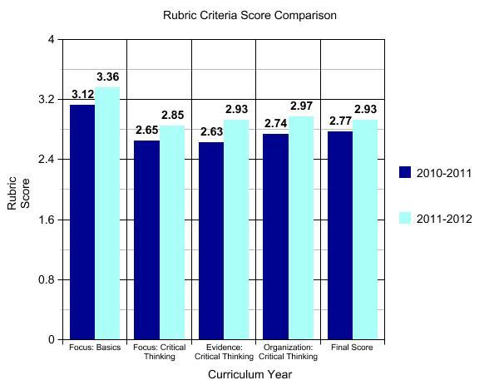
Edits to our historiography project led to higher scores following curriculum revisions. Source: Langbehn et al.
Empower evidence-based curriculum changes

Slide 19
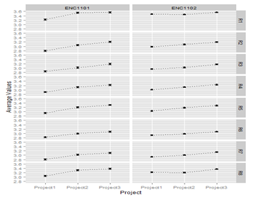
Average project scores for rubric subscores.
N = 26,901 final drafts written by 7,722 students scored by 128 instructors over three years.
Source: Tackitt et al.
Assess student writing by rubric criteria across sections and genres

Slide 20
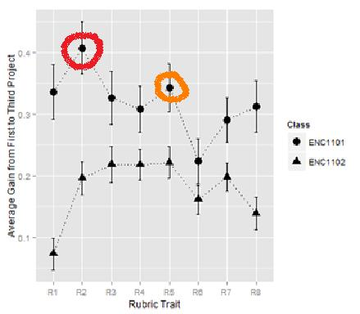
Average gains in final draft scores for 1101 and 1102 from project 1 to project 3 suggest:
Development is not uniform
Development is demonstrated over one term in all areas with greatest gains in critical thinking
N = 26,901 final drafts written by 7,722 students scored by 128 instructors over three years. Source: Tackitt et al.
Assess development by rubric criteria over time
Notes:
4 or 8 traits are CT and 4 of 8 are BS greatest gains are in R2 and R5--CT delineations of focus and organization (r6 - smallest gains basics of grammar)
2)Not Uniform . . . shows that the rubric dimensions are measuring different things

Slide 21
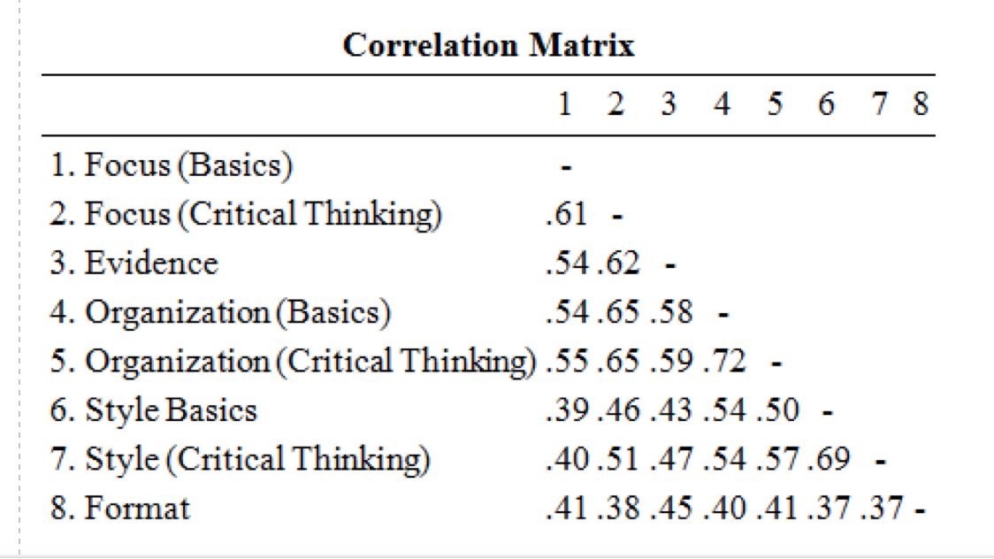
Scores for Organization tend to be most similar to scores for Style:
The largest correlations are between the Basics and Critical Thinking scores for Organization (R4 and R5, with p = .72) and Basics and Critical Thinking for Style (R6 and R7, with p = .69).
Pearson Correlation: Average gains in final draft scores for 1101 and 1102 from project 1 to project 3. N = 26,901 final drafts written by 7,722 students scored by 128 instructors over three years. Source: Tackitt et al
Raise questions regarding correlations among rubric criteria
Notes:
All rubric subscores show statistically significant positive differences between the first and third projects in both 1101 and 1102

Slide 22
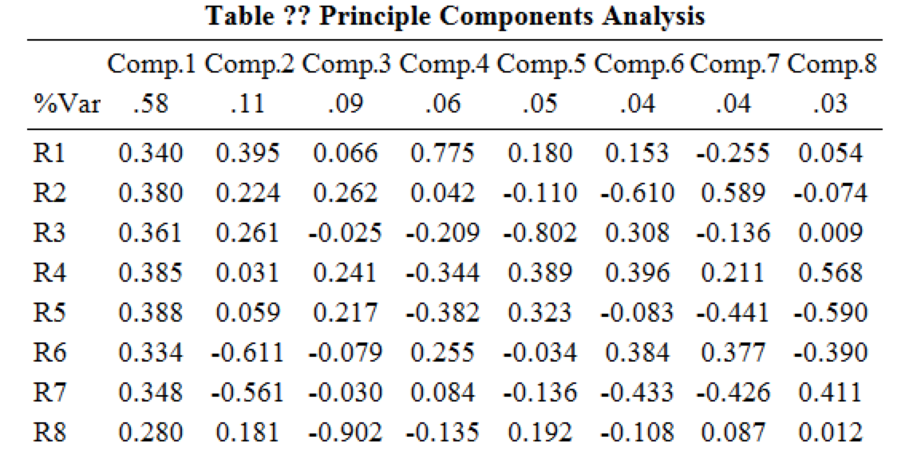
A principle component analysis suggests the 8 individual scores all pull in the same direction.
So if you just had one score--the average--you'd have 58% of the information you're getting from all 8.
Principle Components Analysis: Average gains in final draft scores for 1101 and 1102 from project 1 to project 3. N = 26,901 final drafts written by 7,722 students scored by 128 instructors over three years. Source: Tackitt et al
Suggest instructors consider analytic traits in a holistic manner

Slide 23
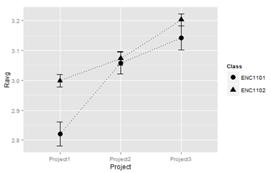
Possible explanations for the gains are that:
Students learn how to write better;
Students learn to write to instructor expectations;
Instructors grade students more easily as the term progresses;
Average of Final Project Averages for ENC 1101 and 1102. N = 26,901 final drafts written by 7,722 students scored by 128 instructors over three years. Source: Tackitt et al.
Suggest hypotheses for future research regarding writing development

Slide 24
Other findings from the study on teachers’ use of a single rubric over the past 3 years:
Students tend to get the same grades on average in 1101 as 1102
On average, there’s a reset effect b/n 1101 and 1102
The students who completed 1101 and then took 1102 show about a .1 bonus over native 1102 students (p-value < 2.2e-16), or better than a one-project lead in development. High-scoring students tend to stay high-scoring students (The strongest trend is for the highest-scoring students to remain so, with 44% of the top quartile in 1101’s first project remaining there by the end of 1102.
Low-scoring students rarely become high-scoring students (Of the lowest scoring 1101 students, 34% will be in the lowest quartile of the last 1102 project. Only 14% of these will reach the highest quartile in 1102.)
Raise questions for future research

Slide 25
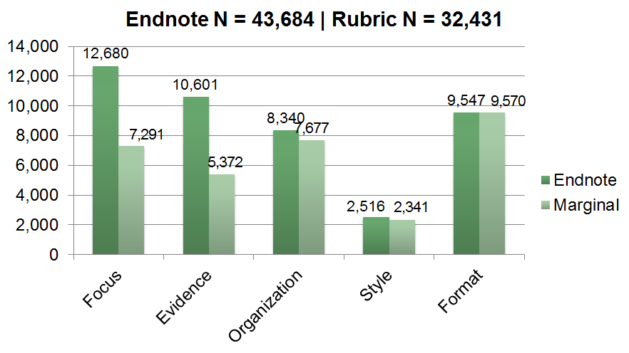
Corpus: Fall 2011 & Spring 2012; 17,433 essays; 101,238 sticky comments; 17,433 endnotes. Source: Dixon & Moxley 2013)
Assess instructor feedback across the writing program

Slide 26
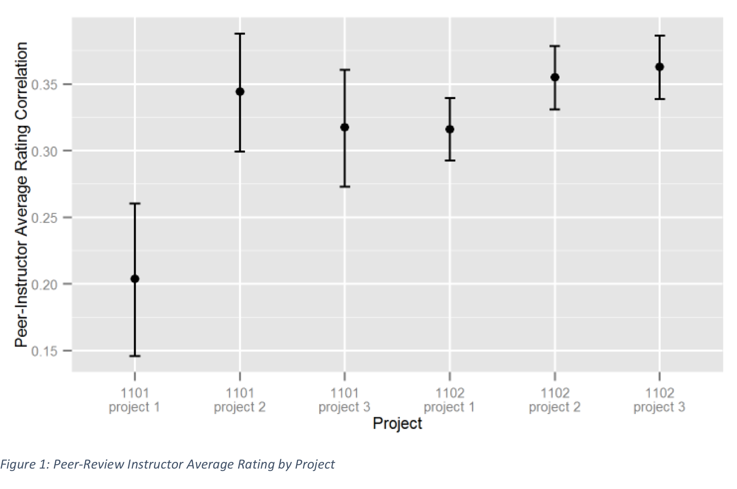
Corpus:
46,689 reviews:
16,312 instructor reviews
30,377 peer reviews;
5,857 students
107 instructors
Spring 2012 to Spring 2014
Course sections: 482 of ENC 1101 or 1102
Measure correlations between instructors’ and students’ scores over time

Slide 27
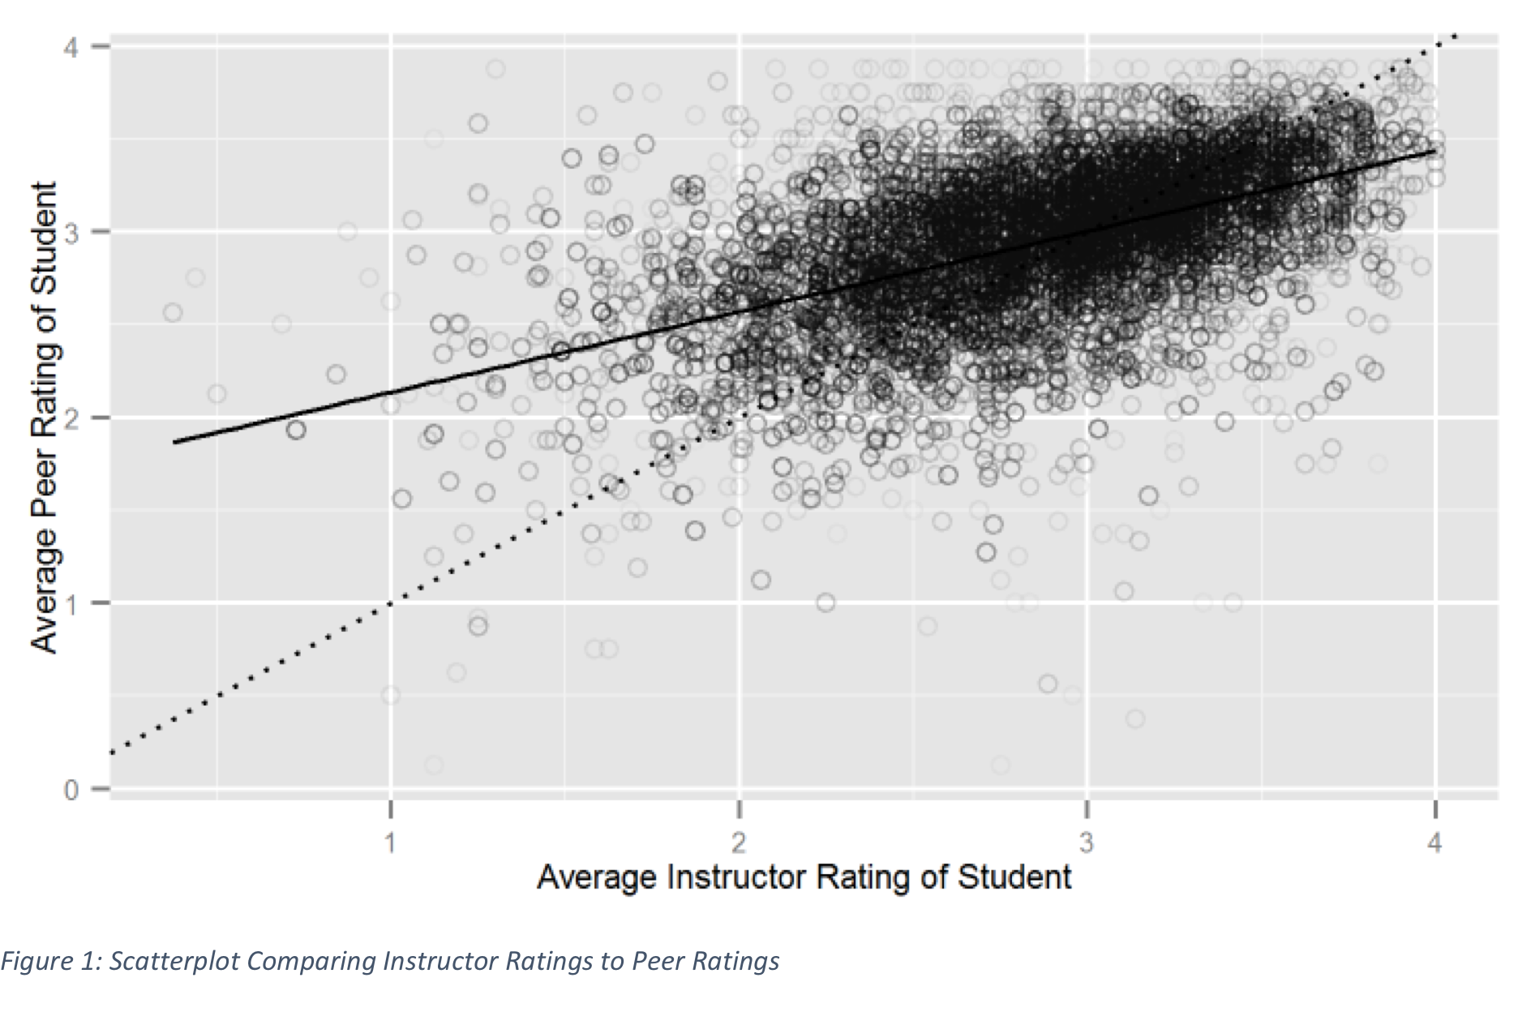
Corpus:
46,689 reviews:
16,312 instructor reviews
30,377 peer reviews;
5,857 students
107 instructors
Spring 2012 to Spring 2014
Course sections: 482 of ENC 1101 or 1102
Identify evidence supporting peer review as a pedagogical practice

Slide 28
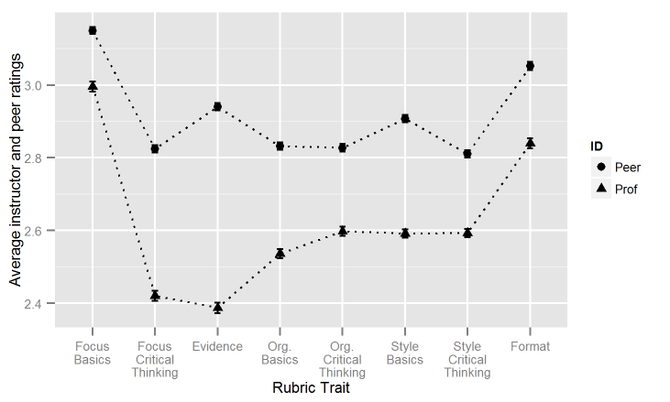
Corpus:
46,689 reviews:
16,312 instructor reviews
30,377 peer reviews;
5,857 students
107 instructors
Spring 2012 to Spring 2014
Course sections: 482 of ENC 1101 or 1102
Analyze instructor and student scores by rubric trait

Slide 29
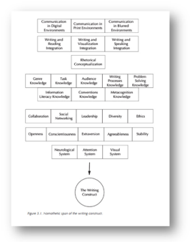
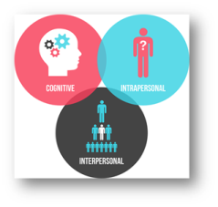
Map the Writing Construct

Slide 30
How would you visually depict Writing Analytics?
We ask that you brainstorm with us in two ways:
First, please use a tool to visualize represent your model of WA and link your picture below. Try Coggle or Google Drawings
Once you decide what’s missing or what’s wrong from our group image (see first iteration below), go ahead and edit the image at Mindomo

Slide 31
Dixon, Z., & Moxley, J. M. (2013). Everything is illuminated: What big data can tell us about teacher commentary. Assessing Writing, 18(4), 241-256.
Langbehn, K., McIntyre, M., & Moxley, J. M. (2013). Re-mediating writing program assessment. In H. Mckee, & D. N. DeVoss (Eds.), Digital writing assessment & evaluation. Utah State University: Computers and Composition Digital Press.
Moxley, J. M. (2012). Aggregated Assessment and Objectivity 2.0. The European Chapter of the Association for Computational Linguistics. Avignon, France 23 April 2012.
Moxley, J. M. (2013). Big data, learning analytics, and social assessment methods. Journal of Writing Assessment, 6(1).
Moxley, J. M., & Eubanks, D. (in progress). Data Mining the Conversation of (Hu)mankind
Tackitt, A., Moxley, J. M., & Eubanks, D. (in press). Big rubrics and big data: The development, transfer, prediction, and restriction of student competencies. Assessing Writing.
Vieregge, Q., Stedman, K., Taylor Mitchell, J., & Moxley, J. (2012). Agency in the Age of Peer Production. Urbana, IL: National Council of Teachers of English.
References

